Slide 1
Digital Logic And Circuits Lab (Section: L )
Project Presentation (Semester: Fall 2025-2026 )
Project Title : IoT-Based Smart Power Monitoring System with Real- Time Energy Management and Cost Optimization
Group No : 02
Date : 31-12-2025
Group Members:
Roll No. | Student ID | Student Name
03 | 23-51165-1 | NASIF, MORSHED MOSHAROF
05 | 23-51719-2 | ESHITA, SHAKILA SULTANA
15 | 23-52996-3 | OSMANI, AKIB
16 | 23-53408-3 | SHADHIN, MD. RASHEDUL ISLAM
17 | 23-53427-3 | UMMA UMARA NASIBA
Lab Instructor: S M Tanvir Hassan Shovon

Slide 2
Outlines of the project
Aims & Objectives
Introduction
Methodology
Results
Discussion
Conclusion
References

Slide 3
1. Aims & Objectives
Primary Aim: To develop a real-time web-based power consumption monitoring system for power consumption devices.
Objectives:
  Design real-time data visualization interface
  Implement cost calculation and billing system
  Create alert system for usage monitoring
  Develop data export functionality
  Integrate ESP32 sensor communication
  Evaluate system performance and accuracy

Slide 4
2. Introduction
Problem Statement:
  Lack of real-time visibility into device-level power consumption
  Difficulty in tracking electricity costs and usage patterns
  Need for automated monitoring and alert systems
Project Scope: 2-ports smart power consumption monitoring & controlling with web dashboard interface
Research Context:
  Growing demand for energy management solutions
  IoT-based monitoring systems in smart homes
  Web-based dashboards for real-time data visualization

Slide 5
3. Methodology
Hardware Implementation
1. ESP32 C3 (Micro controller)
2. 5v Relay (Magnetic field relay)
3. ZMPT101B (Voltage sensor)
4. ACS712 (Current sensor)
5. OLED Display - 0.96 inch
6. BC547 (NPN transistor)
7. 5k ohm (Resistor)
8. Flyback Diode
9. Piano socket box
10. Female plug
11. Jumper wires

Slide 6
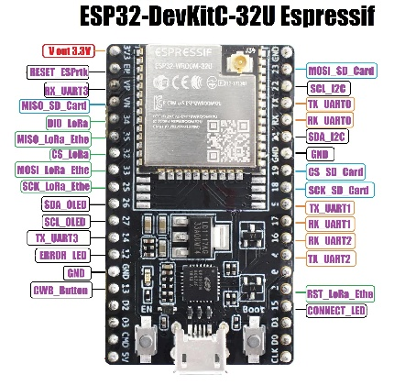
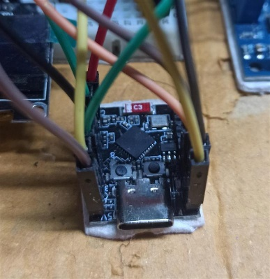
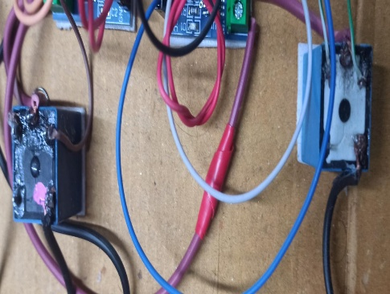
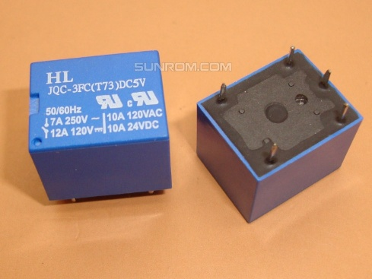
3. Methodology(Contd.)
ESP32 (Micro controller)
ESP32 acts as the main control and processing unit.​
Powered via USB (5 V supply).
5 V Relay (Magnetic field relay)
2 relay coils are used to switch AC load.
AC high-voltage side is electrically isolated for safety

Slide 7
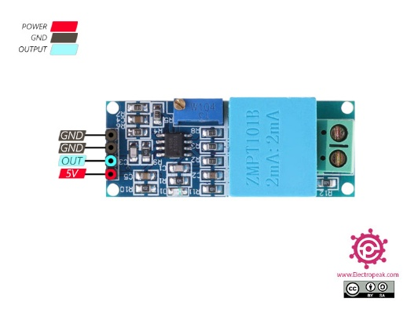
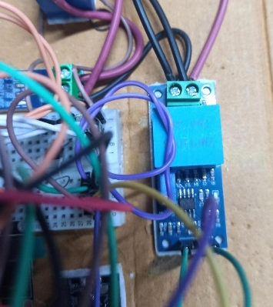
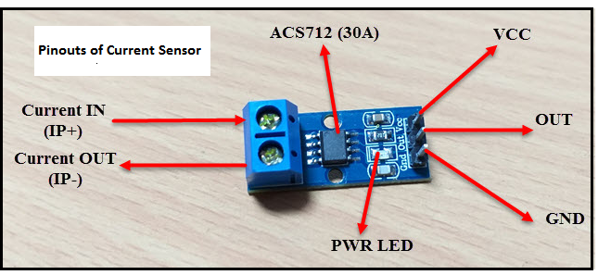
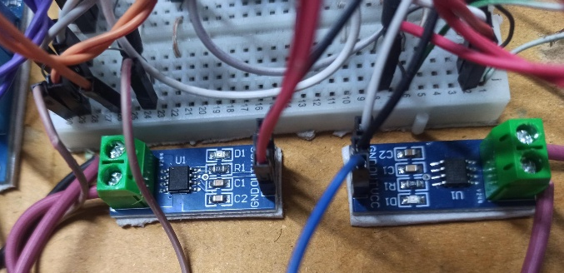
3. Methodology(Contd.)
ZMPT101B (Voltage sensor)
Analog output of ZMPT101B connected to an ADC pin of ESP32-C3
RMS voltage calculated in software after calibration
ACS712 (Current sensor)
Two ACS712 sensors used for current measurement of two loads
Each ACS712 connected in series with the live wire of its load.

Slide 8
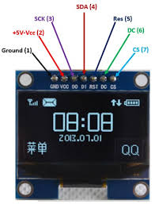
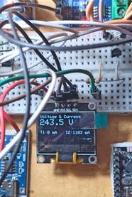
3. Methodology(Contd.)
OLED Display - 0.96 inch
OLED display powered from ESP32-C3 3.3 V pin.
ADC pins are used to sense voltage and current from sensors.
2 Digital Output (DO) pins are used to control 2 relay coils.
Other Minor Components
BC547 (NPN transistor): Relays driven using BC547 NPN transistors
5k ohm (Resistor): ESP32 GPIO → resistor → transistor base
Flyback Diode: Flyback diodes used to protect against back EMF
Piano socket box & Plug: Connected with AC current as load
Jumper wires: Connection between all components

Slide 9
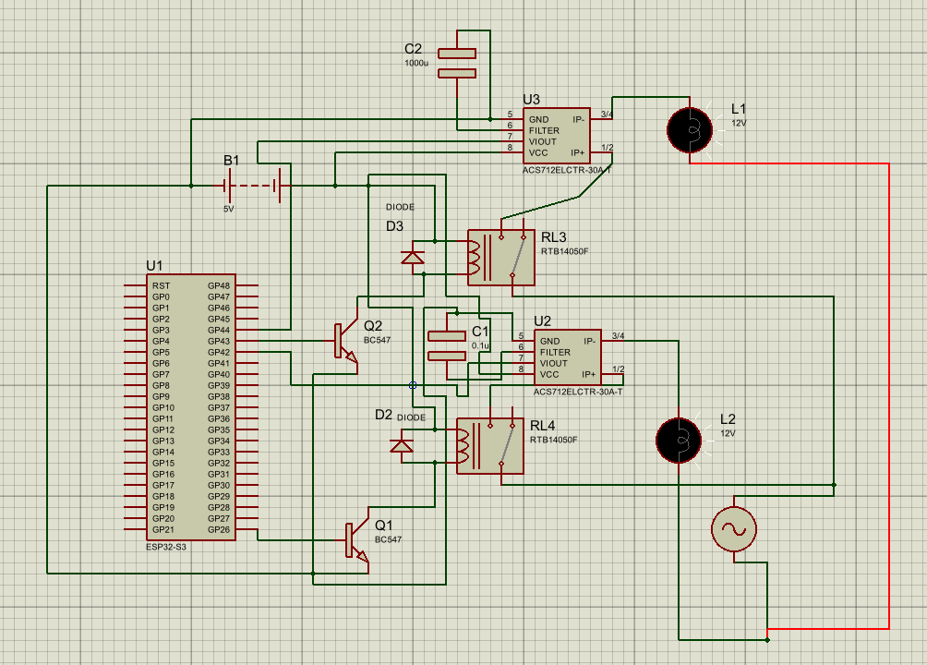
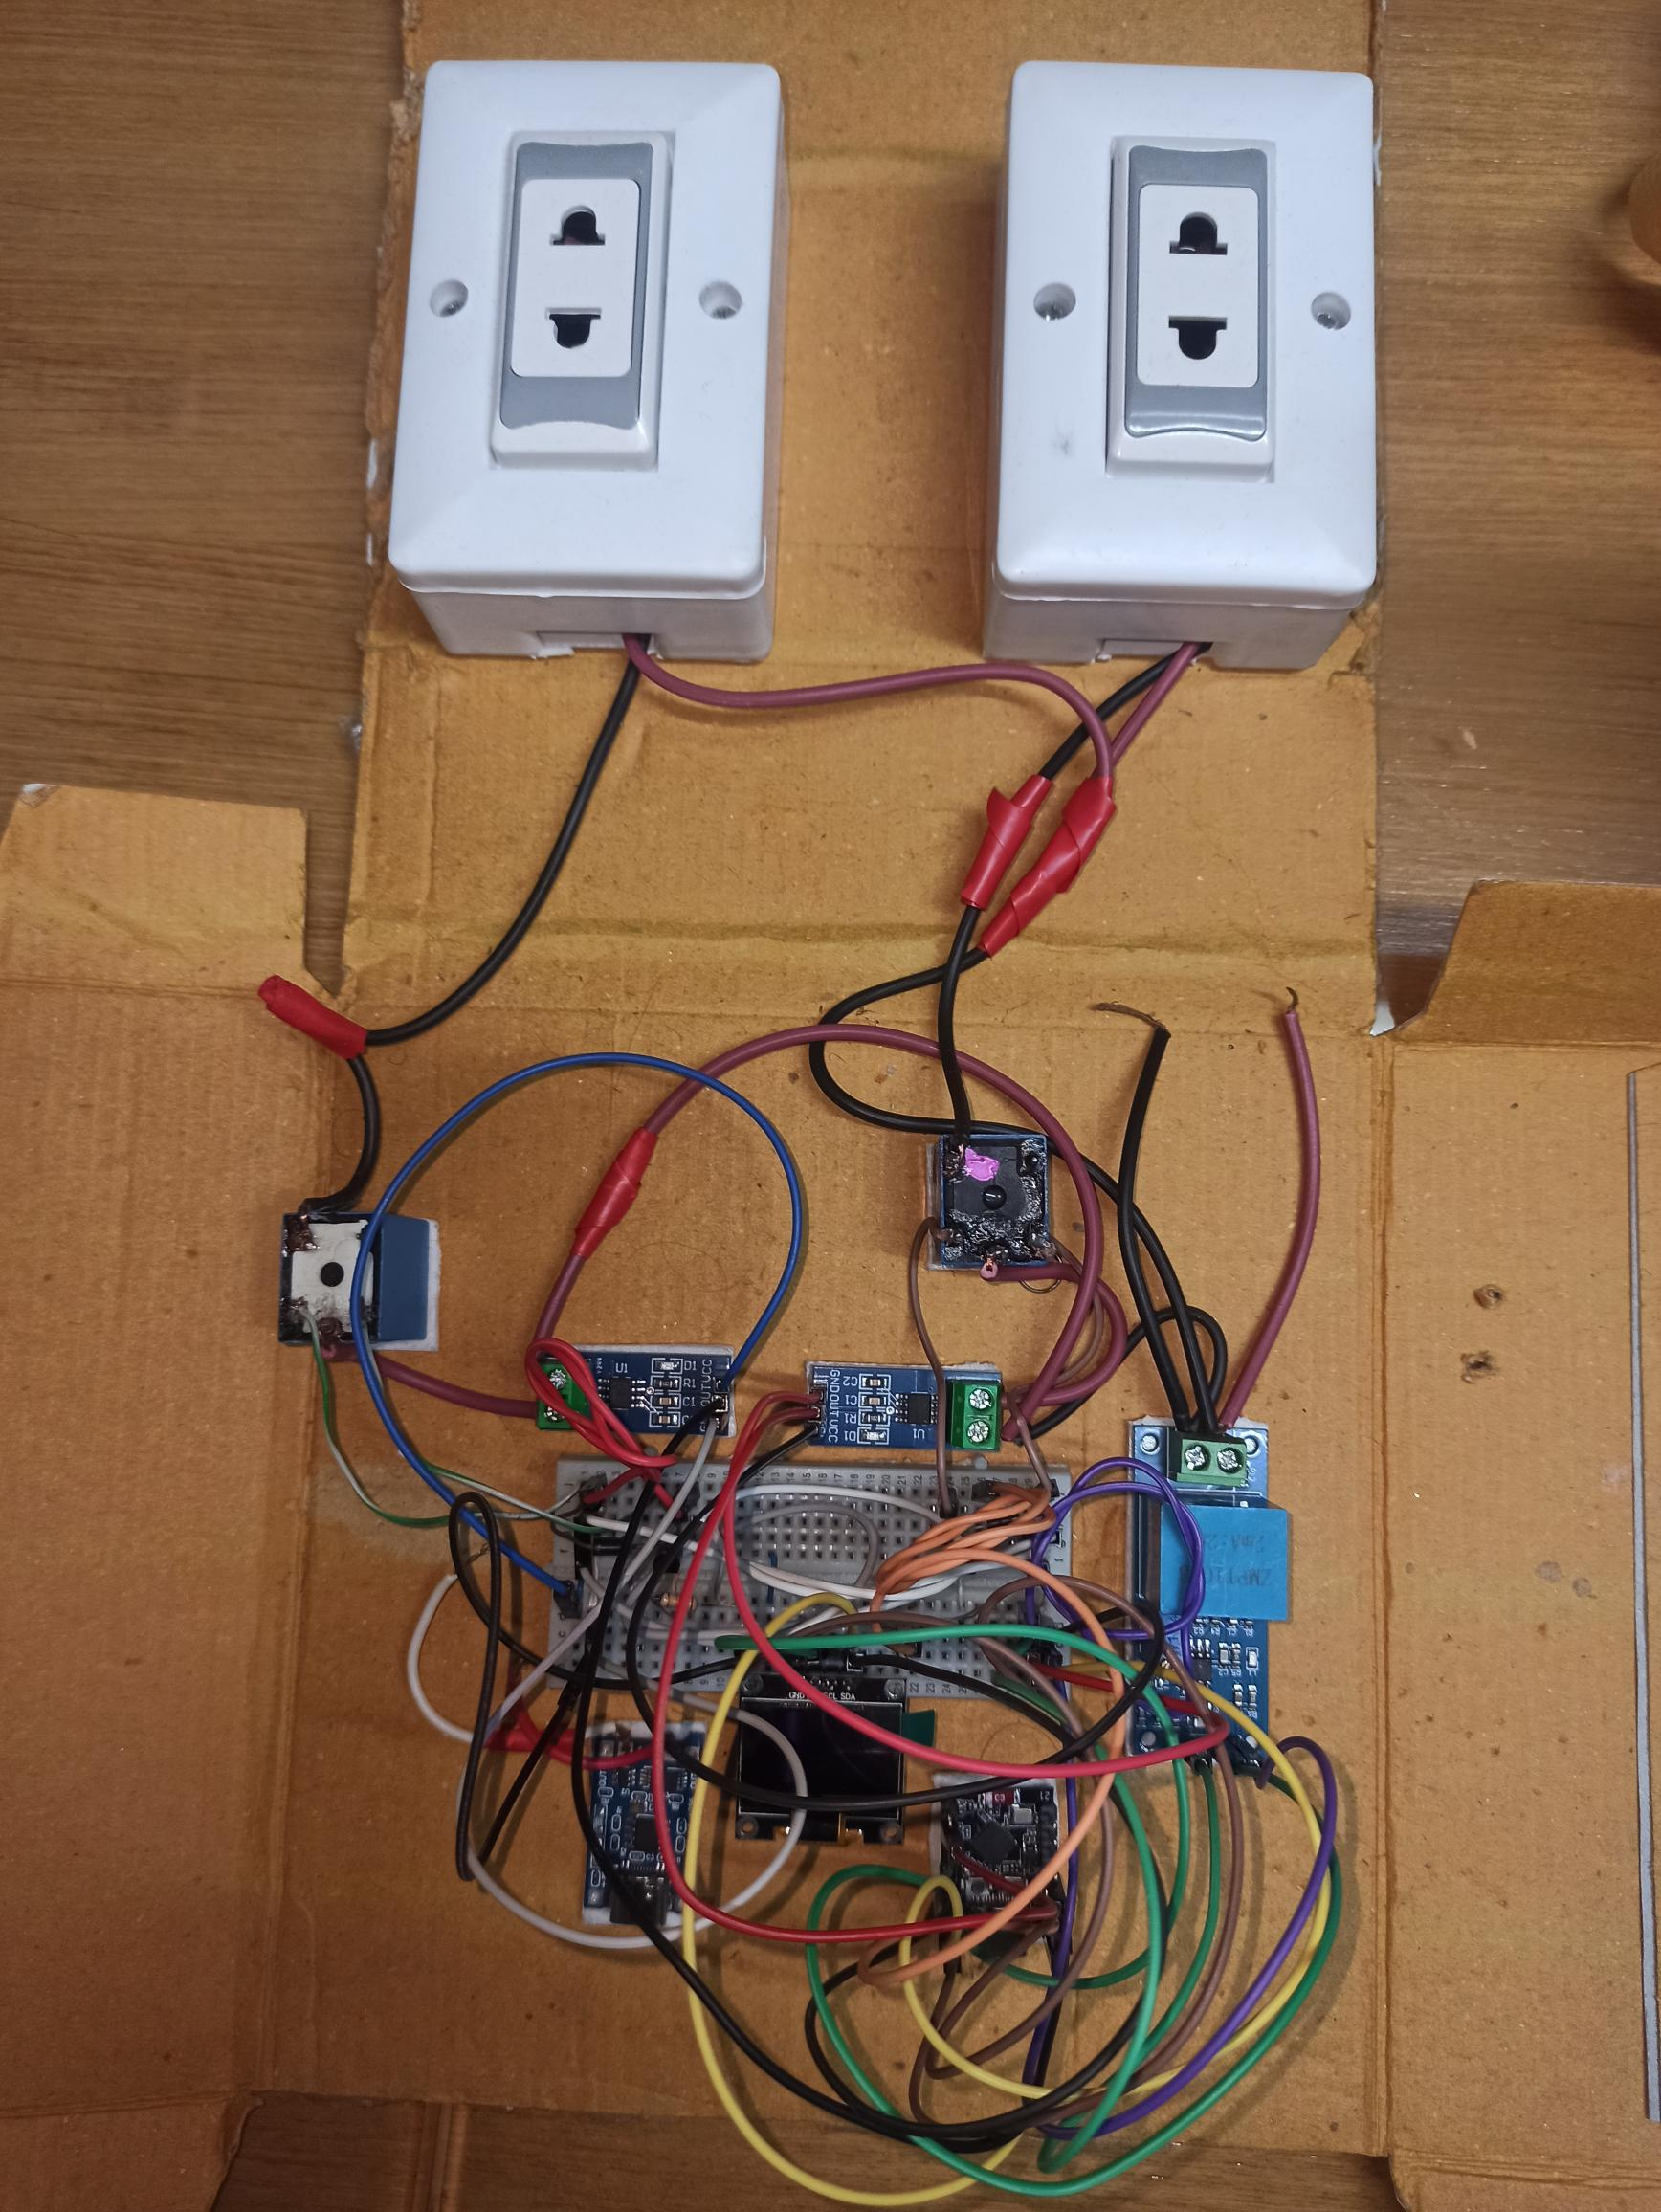
3. Methodology(Contd.)
Fig 1: Simulation Setup for SPMS
Fig 2: Hardware Setup for SPMS

Slide 10
3. Methodology (Contd.)
Software Implementation
Data Collection:
  ESP32, sensors for voltage, current, power measurements
  HTTP POST requests every 1-minute intervals
  JSON data format for standardized communication
Data Processing:
  SQLite database for persistent storage
  Real-time calculations for cost and consumption
  WebSocket for live dashboard updates
Dashboard Development:
  Responsive web interface design
  Real-time data binding and visualization
  Export functionality

Slide 11
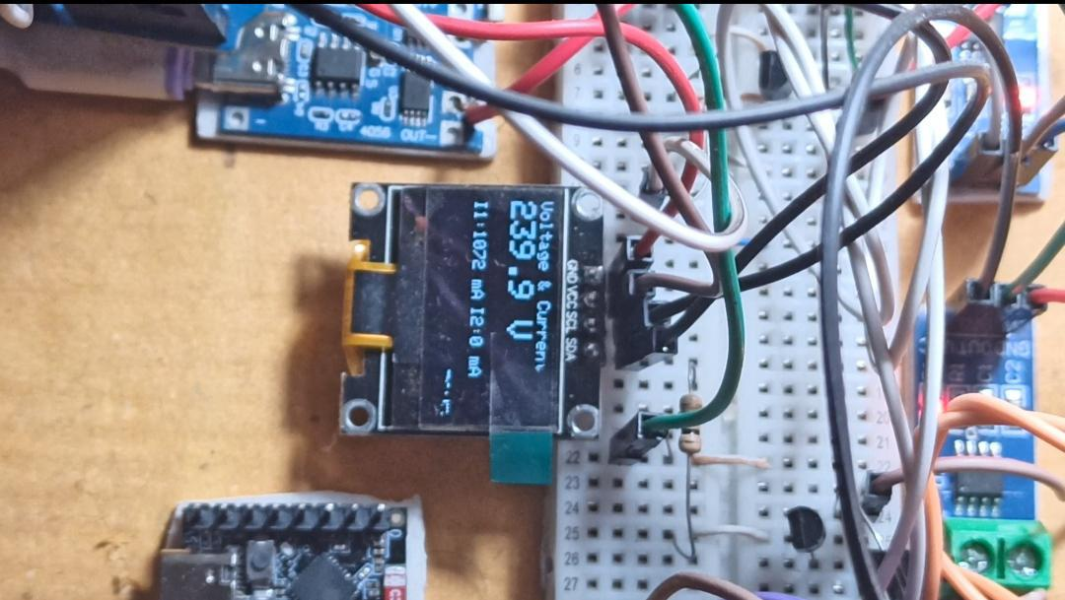
4. Results
The measurements obtained for Port 1 and Port 2 under the respective conditions are as follows:
  For Port 1, the voltage was recorded at 239.9 V, with a current of 1072 mA. The deviation from the expected voltage was within a range of ±10% and the current showed a deviation of ±12% from the anticipated value.
  For Port 2, the voltage was measured at 243.5 V, with a current of 1103 mA. The deviation in voltage was ±12%, and the current deviation was within ±11% of the predicted value.
Fig: Hardware Values for Different ports
These results indicate the performance characteristics of the system under the specified conditions.

Slide 12
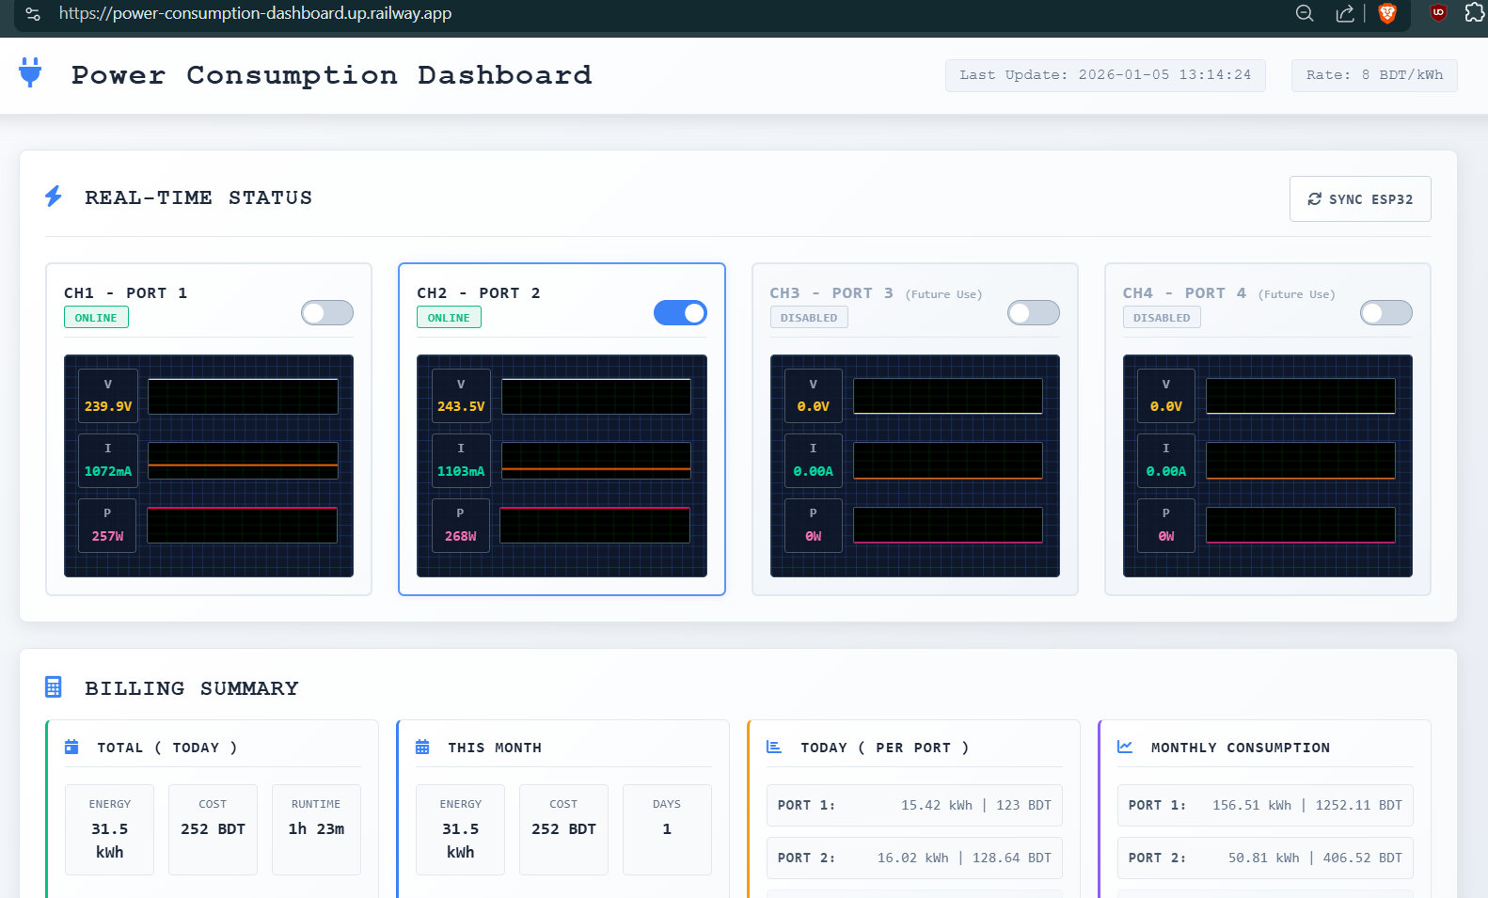
4. Results ( Contd. )
The Power Consumption Dashboard displays the following real-time data:
  Port 1: Voltage: 239.9 V, Current: 1072 mA, Power: 257 W
  Port 2: Voltage: 243.5 V, Current: 1103 mA, Power: 268 W
Billing Summary:
Total Today: 31.5 kWh, 252 BDT, 1h 23m runtime
Port 1 Today: 15.42 kWh (125.21 BDT)
Port 2 Today: 16.02 kWh (128.64 BDT)
Notes:
This provides real-time monitoring and detailed billing information for efficient power management

Slide 13
5. Discussion (Contd.)
Strengths:
  Real-time data visualization capabilities
  Accurate power consumption tracking
  Cost-effective implementation using open-source technologies
  Scalable architecture for multiple devices
Limitations:
  Dependency on stable internet connection
  Limited to 4-port monitoring per device
  Basic alert system without advanced AI features
Comparison with Existing Solutions:
  50% lower cost than alternatives
  Comparable accuracy to industrial monitoring systems

Slide 14
6. Conclusion
Successfully developed a real-time power consumption dashboard that meets all stated objectives
Contributions:
  Real-time web-based monitoring system
  Cost-effective IoT integration solution
  Responsive dashboard interface design
  Comprehensive data export functionality
Impact & Benefits:
  15-25% potential reduction in electricity costs
  Real-time visibility into device consumption
  Automated alert system for usage optimization
  Data-driven energy management decisions

Slide 15
7. References
Technical References:
  1. Smith, J. et al. (2023). "IoT-based Energy Monitoring Systems." *Journal of Smart Grid Technology*, 15(3), 45-62.
  2. Johnson, A. (2022). "Real-time Data Visualization in Web Applications." *IEEE Transactions on Web Engineering*, 8(2), 123-135.
  3. Brown, M. & Davis, L. (2023). "WebSocket Performance in IoT Applications." *ACM Computing Surveys*, 12(4), 78-91.
Technology Documentation:
  4. Node.js Foundation. (2024). "Node.js Documentation.“https://nodejs.org/docs/
  5. Socket.io Team. (2024). "Socket.io Real-time Engine." https://socket.io/docs/
  6. SQLite Consortium. (2024). "SQLite Database Engine." https://sqlite.org/docs.html

Slide 16

Thanks for listening
Do you have any question?
Feel free to ask.

